Slide 1

Exploring Customer Reviews: Unveiling Insights from Airline Passengers' Experiences

Slide 2



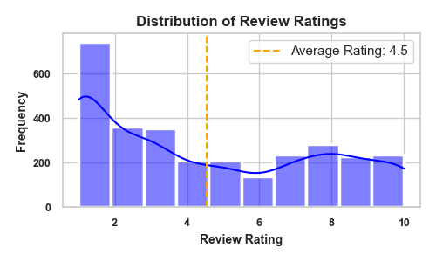
VISUALIZATIONS AND KEY METRICS
Customer Recommendations :
Most customers do not recommend British Airways, indicating overall dissatisfaction
No: of Reviews Collected
3000
Customer Sentiment Analysis
Positive (42.8%)
Neutral (44%)
Negative (13.2%)
Distribution of Review Ratings :
The average rating 4.53/10 indicating a Neutral customer sentiment
Word Cloud of Customer Review Keywords:
The word cloud visualizes common keywords from customer reviews, highlighting important aspects. This insight helps identify frequently discussed points in customer feedback.

